Slide 1
You Only Look Once: Unified, Real-Time Object Detection
Members:
Dipti Chaudhari
Ankitha Gajaram

Slide 2
Introduction
Humans glance at an image and instantly know what objects are in the image, where they are, and how they interact.
The human visual system is fast and accurate, allowing us to perform complex tasks like driving with little conscious thought.
Current detection systems repurpose classifiers to perform detection. To detect an object, these systems take a classifier for that object and evaluate it at various locations and scales in a test image.

Slide 3
Abstract
We present YOLO, a new approach to object detection. Prior work on object detection repurposes classifiers to perform detection.
Our unified architecture is extremely fast. Our base YOLO model processes images in real-time at 45 frames per second.

Slide 4
Proposed System
The YOLO Detection System. Processing images with YOLO is simple and straightforward. Our system
1.resizes the input image to 448 × 448,
2.runs a single convolutional nettwork on the image, and
3.thresholds the resulting detections by the model’s confidence.

Slide 5
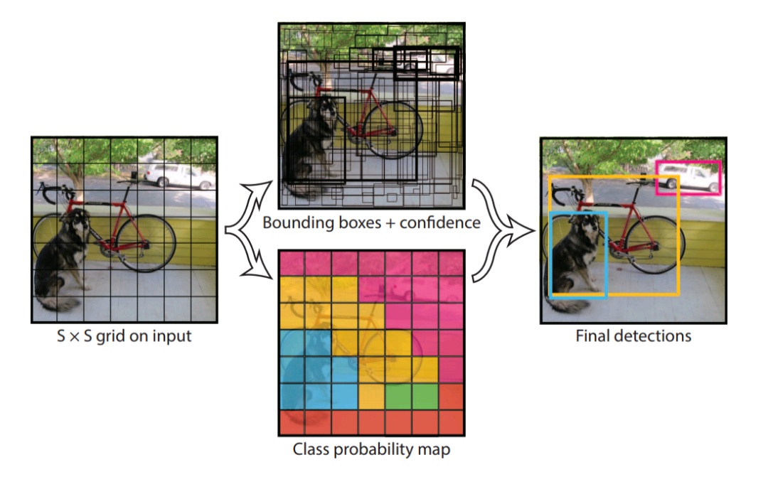

Slide 6
Technology Stack
Python: Yolo machine learning model will be developed by using Python Programming Language as it is OOPs based, high level, interpreted programming language. It is a robust highly useful language focused on rapid application development.
Android Studio: For Application Development i.e to take images and show output.

Slide 7
Libraries
TensorFlow Lite is TensorFlow’s lightweight solution for mobile and embedded devices. It enables on-device machine learning inference with low latency and a small binary size. TensorFlow Lite also supports hardware acceleration with the Android Neural Networks API.

Slide 8
Dependencies
Image of subject :- The more images fed to the model the more accurate will be the prediction
Tensorflow lite :- Tensorflow lite enables integration of Tensorflow in mobile devices.

Slide 9
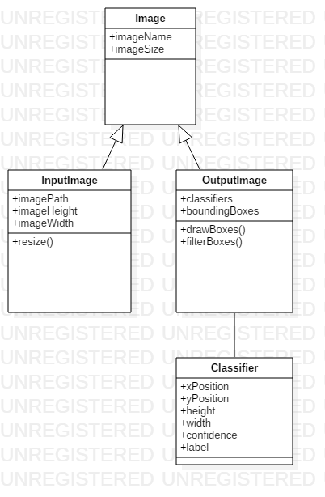
Class Diagram

Slide 10
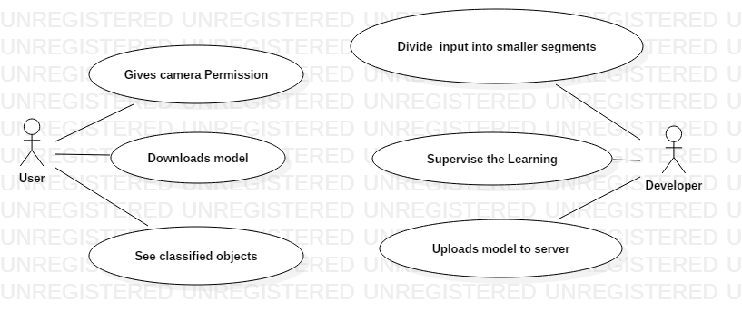
Use Case Diagram

Slide 11
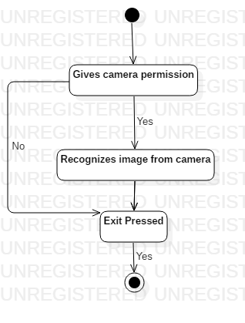
Activity Diagram

Slide 12
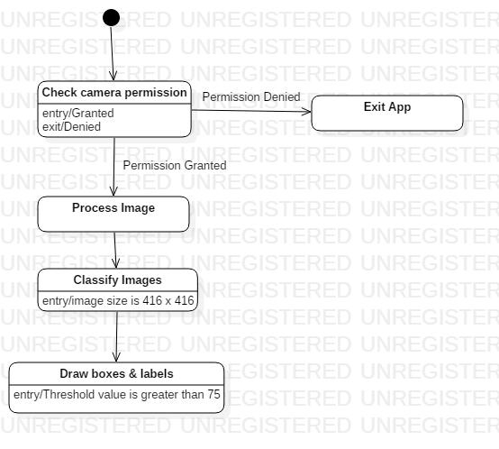
State Diagram

Slide 13
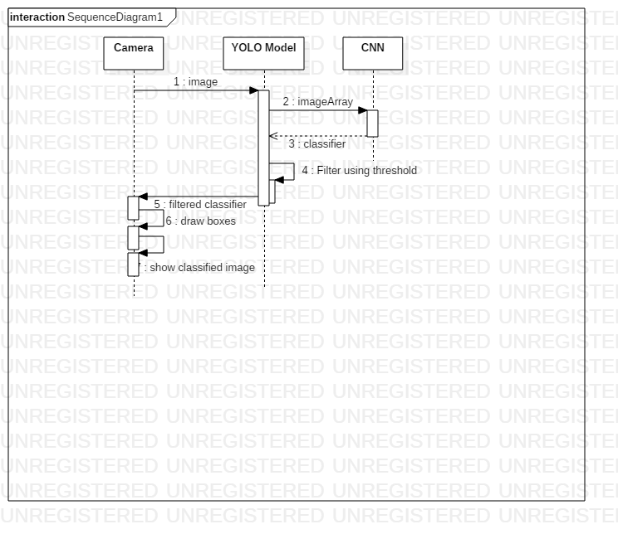
Sequence Diagram

Slide 14
Thank You

